Slide 1
EDUCATIONAL OS PROJECT
Presented , prepared and written by Christian Vinthenga
25 311 351 023

Slide 2
WHAT I BUILT

Slide 3
I have built an EduOS (Educational Operating System Simulator).
This is a small operating-system simulation project made of two different parts which is python and c programming languages
C programming language is used to simulates low-level OS behaviour whereby python is used handle CPU scheduling algorithms and controlling the whole OS simulator.
EduOS Simulator is divided into parts which are;

Slide 4
1. C CORE SIMULATION PART
This comprises of c programs which are bundled together inside the file that execute all function stored inside all .c files
It contains process management where the process manager is mainly used to create Process control block (PCB) and Stores process information which are PID, arrival time, burst time , priority and also state of the process.
Thread managements which focuses on which thread must use the CPU first or resolve the problem where two or more thread want to use the same resource at the same time.

Slide 5
2. PYTHON SIMULATION PART
Inter-process-communication(IPC) which enable two or more processes to access shared resources either for writing or reading data.
This is where different algorithms are implemented and later the outputs are represented using gantt charts, comparison bar charts, timeline animation
Main controller act as a bridge between c and python programs which also bundle both parts together and execute them together

Slide 6
3. INTEGRATING C AND PYTHON
C and Python files are put together by the use of pcb_snapshot.json which is created inside the c system.
Python scheduler read the data that is inside pcb_snapshot.json hence connecting two parts which are python and c parts.
This is also called full system integration since two major parts that are used to build EduOS are connected together forming one project

Slide 7
WHAT I LEARNED

Slide 8
I have learned how to link local project to github using commands and terminal and also how to work with github concerning add and removing files.
I learned that the operating system must store and manage process information before it can schedule or execute anything and the importance of Process Control Block
I learned how a Central Processing Unit (CPU) decides which process must execute next.
I learned how multiple threads work inside one process which is called multithreading and concurrency and also how they are able to run simultaneously.

Slide 9
DESIGN DECISIONS

Slide 10
Process Control Block (PCB) is used since it stores all information about a process such as Process ID, Process state, arrival time of the process etc. which also help in context switching and process management.
POSIX is used since allows two processes to access the same memory directly hence making it faster than message queues since POSIX has no repeated data copying
POSIX is also suitable for exchanging process metrics and PCB data than message queue which is slower in exchanging processes.

Slide 11
Design choices with reference to OS theory
Multiple CPU scheduling algorithms implemented. This is when FCFS, SJF, Priority scheduling, Round Robin and Priority scheduling are used whereby different algorithms are designed to optimize different goals.
POSIX shared memory chosen over message queues for IPC. This is whereby multiple processes are able to access the same memory directly, making communication much faster and synchronization is also used.
Fixed-Size thread pool for concurrency. This is when instead of creating a new thread for every task, this was implemented. It allows worker threads to be created once and reused, improving efficiency.
Using c struct which store process information such as PID, Burst time, Arrival time, Process state etc. It provides a fixed and organized memory layout hence updating and accessing process information faster

Slide 12
SYLLABUS MAPPING TABLE

Slide 13
SYLLABUS MAPPING TABLE
Syllabus Topic | How EduOS Implements It | File / Line Reference
Process control Block | PCB implemented using C struct to store process metadata | C_core/process_manager.c, include/eduos.h
Process state and management | Tracks process lifecycle creates, stores, & exports process information to JSON | C_core/process_manager.c
Scheduling algorithms | Simulates process scheduling using multiple algorithms | Python_scheduler/scheduler_sim.py
Inter-process communication | Implements communication between processes | C_core/ipc_module.c
Multithreading basics | Creates and manages POSIX threads | C_core/thread_manager.c
Thread creation and libraries | Uses pthread_create() to run concurrent tasks | C_core/thread_manager.c
Race and fixed condition | Shows safe/unsafe shared counter updates with and without synchronization | C_core/thread_manager_race.c & thread_manager_fixed.c

Slide 14
SCHEDULING RESULTS & ANALYSIS

Slide 15
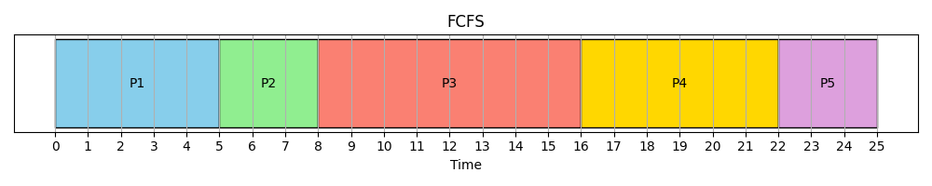
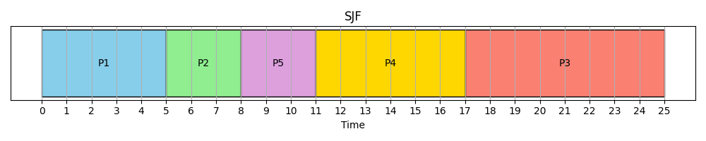
FCFS & SJF Result and Analysis
FCFS results and analysis
SJF results and analysis
First process that reaches the CPU are executed first before others
These processes are put in a queue so that they can be executed one by one to the end before moving to the next process
P1, P2, P3, P4 and P5 are process that are executed in order depending on first come first serve criteria
It has highest waiting time of 6.50 since processes wait for each other
First process always execute first even without following the algorithm criteria.
This is where processes given to CPU to execute, are executed in order depending on how short these processes are.
Processes that take less time execute first before others
It has lowest waiting time of 4.25

Slide 16
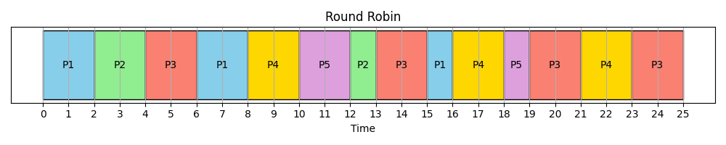
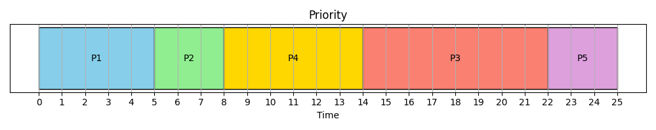
RR & Priority Results and Analysis
RR results and analysis
Priority results & analysis
This is where processes given to the CPU are given a fixed unit of time where each process can use for execution before moving to the next process
All process are give 2 unit of time to execute and next process start execute even if the running process has not completed executing
The have higher waiting time which is lower comparing to FCFS wt
Processes that has higher priority are the ones which CPU execute first before other, even if they are longer.
This improves urgent task responsiveness but may increase average waiting time for others.
Priority scheduling performed better than FCFS but not always better than SJF and It has average waiting time of 5

Slide 17
ALGO WITH LOWEST WT, WHY & WHEN WOULD A DIFFERENT ALGO WIN

Slide 18
Short job first algorithm (SJF) is the one that has the lowest waiting time since processes that takes less time to execute are executed first before the other on the same given dataset.
FCFS would win when simplicity is important, all burst times of the processes are similar and when scheduling overhead is supposed to be minimal.
Priority Scheduling would win when urgent tasks must run first, real-time or critical processes exist for example operating system interrupts can always execute first since it has higher priority.
Round Robin would win when system is more interactive, users need quick response time, fairness matters more than minimum waiting time for example desktop operating systems

Slide 19
THREADING ISSUES ENCOUNTERED

Slide 20
RACE CONDITION & HOW TO FIX IT.
Race condition is when multiple threads are accessing and modify shared data without proper synchronisation. This is one of the threading issues that is encountered when working with multiple threads and it is a major concurrency problem which is implemented in thread_manager_race.c
Multiple threads are created using pthread_create() function where each thread attempted to update the same shared variable. Hence making their operations to overlap unpredictably.
The output of threads of each execution changes because threads overwrite each other`s updates before they are fully completed.
This problem is fixed using a mutex in thread_manager_fixed.c where a critical section is protected. It works by enabling one thread to enter the critical section at a time hence producing stable and correct output after running

Slide 21
C vs PYTHON: Lessons Learned

Slide 22
WHAT I HAVE LEARNED ABOUT C & PYTHON
Implementing EduOS in both C& Python demonstrates the difference between low-level and high-level programming .
Process management& threading in c requires manual handling of resources and synchronisation. For example, thread_manager_race.c showrace condition which produce inconsistent results and thread_manager_fixed.c is used to fix he race condition using mutex locks.
Shared memory and pipes in ipc_module.c requires direct interaction with operating system resources which helps in internal working of IPC. The implementation provide deeper understanding of concurrency, resource management.
Same scheduling concepts in python is much easier to implement. In scheduler_sim.py, ready queue is managed using python lists & objects instead of manual memory management.
Scheduling Algorithms are written more quickly and clear and these algorithms can be converted into visualisation through the use of gantt.py where python modules Matplotlib are used to generate charts and comparison graphs.
Overall, C provides low-level control and understanding of operating internals, while python improved readability development and visualisation. Using both programming languages together provides experience with different abstraction levels.

Slide 23
CHALLENGES & SOLUTIONS

Slide 24
CHALLENGES AND SOLUTIONS
Header file not found inside eduos.h While compiling the C modules GCC produce error like “No such file or directory” . This problems occur because the header file that in supposed to be present or used in one of the C programs is not available inside he file that holds all header files used in C_core/ . This was fixed by placing the needed header file inside the eduos.h and using the correct code in compilation.
Failing to save generated images automatically. Generated charts by gantt.py fails to save themselves because the output directory did not exist. This can be solved by using exact path written in os.makedirs(). And make sure that .png and .gif files are stored successfully.
Using a different local name to the one that is used as repository name. This problem lead to the creation of new repository which is wrong hence invited a collaborator in one repository may not have access to another repository without invitation. Using the same name for both repository and local project and make sure that the collaborator is in the right repository before linking the github repository to the local project.

Slide 25
GITHUB SUMMARY

Slide 26
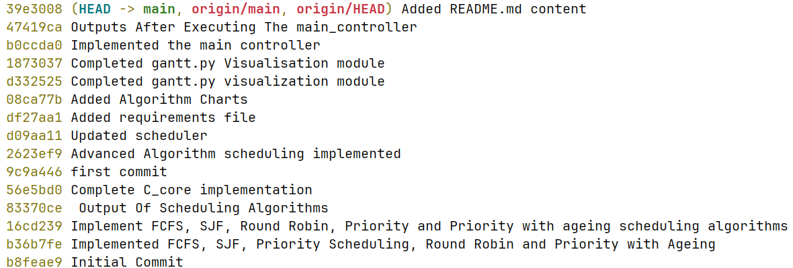
LINK, COMMITS & BRANCHING STRATEGY USED
Repository URL : https://github.com/christianvinthenga408-cell/Operating-System-Assignment-1.git
Total commits : 16 commits
Screenshot of the last 15 commits
It uses single-branch development strategy which focuses on developing major components step by step and tested before moving to the next feature.
This branching strategy involves setting up the structure, creating PCB and process management module, implement threading condition, developing ipc module, implementing scheduling algorithms in python, generating charts and graphs and writing documentation and reports
This strategy helped in maintaining organisation and consistency throughout the development process.

Slide 27
THANKS FELLAS!

